Slide 1
Amazon Prime Content Analysis
Movies & TV Shows Performance Dashboard
Syed Fakhruddin

Slide 2
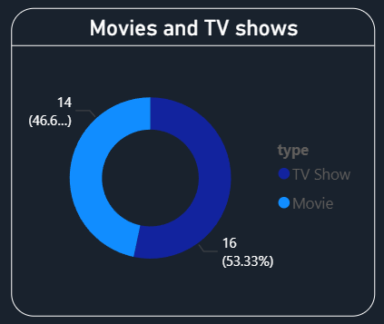
Content Type Distribution

Slide 3
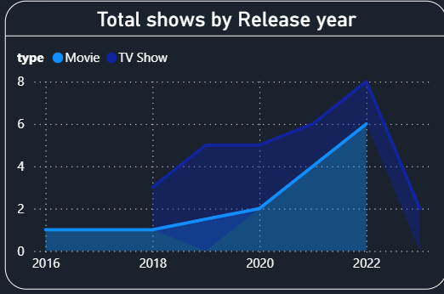
Content Growth by Release Year

Slide 4
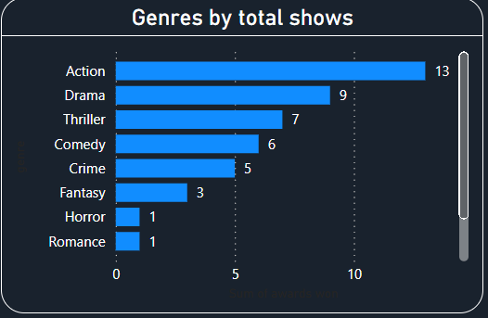
Genre Distribution Analysis

Slide 5
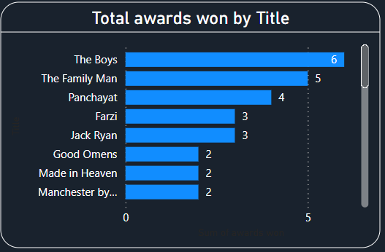
Awards Performance Analysis
.

Slide 6
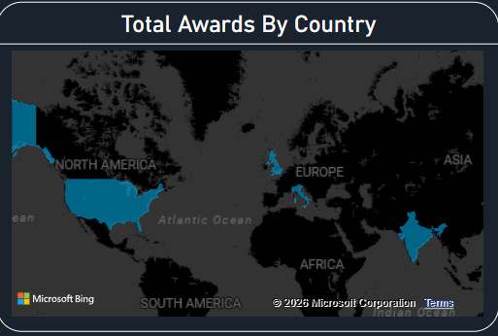
Country & Audience Target Analysis

Slide 7
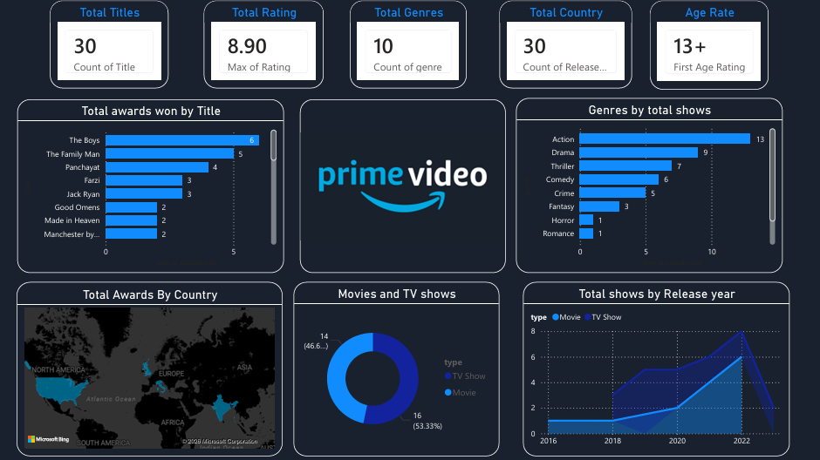
Amazon prime content Analysis

